Slide 1


Web Scraping of
http://www.sortra.com/ryuji-shiba-puppy/

Slide 2
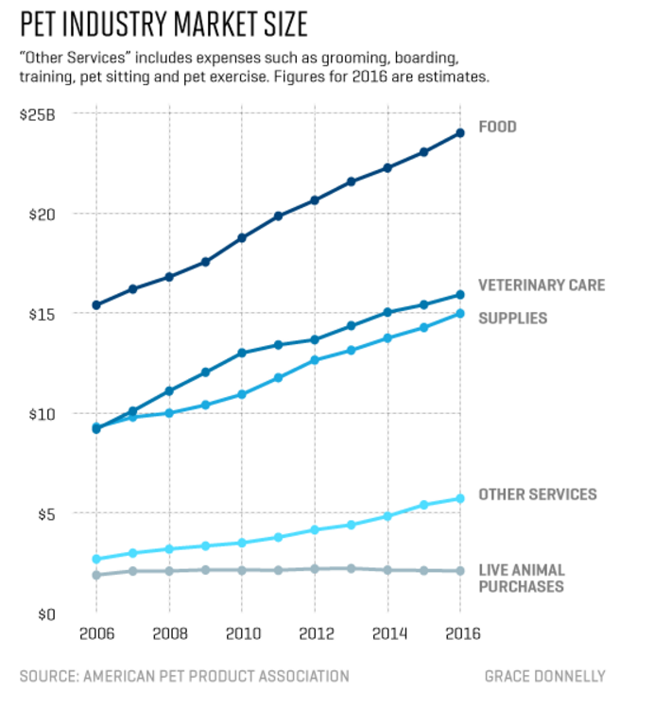
The pet industry has grown three-fold since 1996.
The pet industry continued to grow through the Great Recession (2007 – 2009)
http://fortune.com/2016/09/07/pets-are-basically-people/
https://www.washingtonpost.com/news/business/wp/2016/09/13/millennials-are-picking-pets-over-people/?utm_term=.ec61e57b7dfe
Notes:
Owners’ love for their pets has made the industry a resilient one. As president and CEO of the APPA, Bob Vetere has been tracking pet spending for decades. From 2007 to 2009, the heart of the financial crisis, the business of pets grew more than 10%. “People cut back on vacations, they cut back on the number of times they go out to eat, they cut back on a lot of other things -- but they’re not going to get rid of their pet,” he says.
http://fortune.com/2016/09/07/pets-are-basically-people/

Slide 3
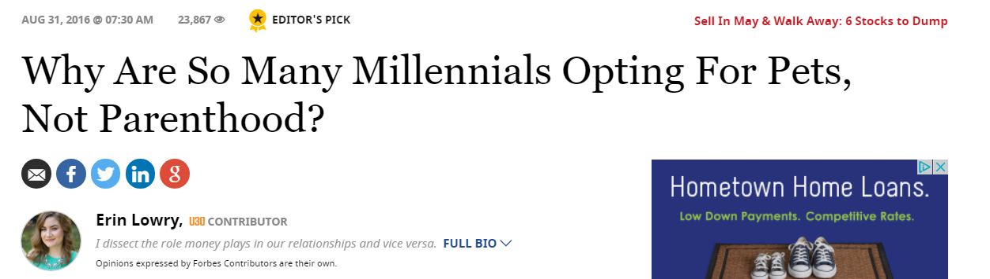


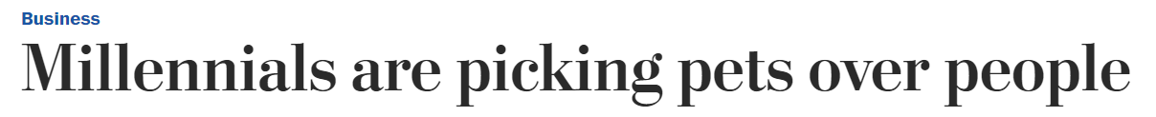

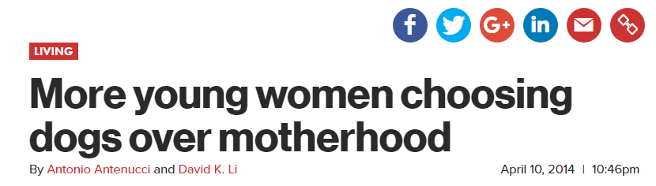
http://nypost.com/2014/04/10/more-young-women-choosing-dogs-over-motherhood/
https://www.forbes.com/sites/erinlowry/2016/08/31/why-are-so-many-millennials-opting-for-pets-not-parenthood/#50ff1f433963
https://www.washingtonpost.com/news/business/wp/2016/09/13/millennials-are-picking-pets-over-people/?utm_term=.ec61e57b7dfe
Notes:
Lifetime ocst of pet: $32,850
http://5kids1condo.com/3-ways-tech-can-save-you-money-pets/
Lifetime cost of child: $233,610
http://money.cnn.com/2017/01/09/pf/cost-of-raising-a-child-2015/
Millennial men more likely to have pets

Slide 4
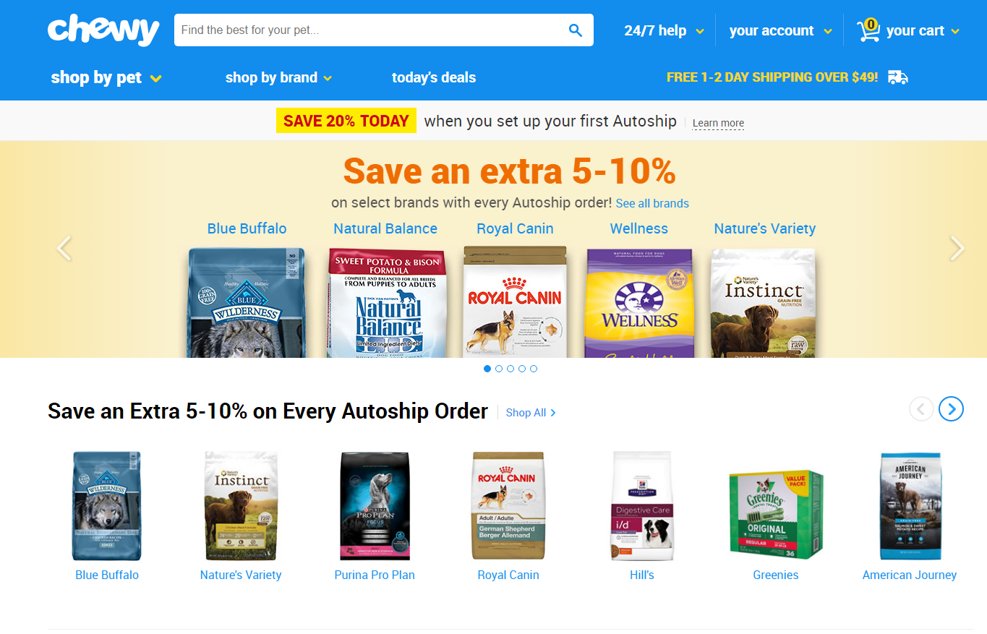

Slide 5
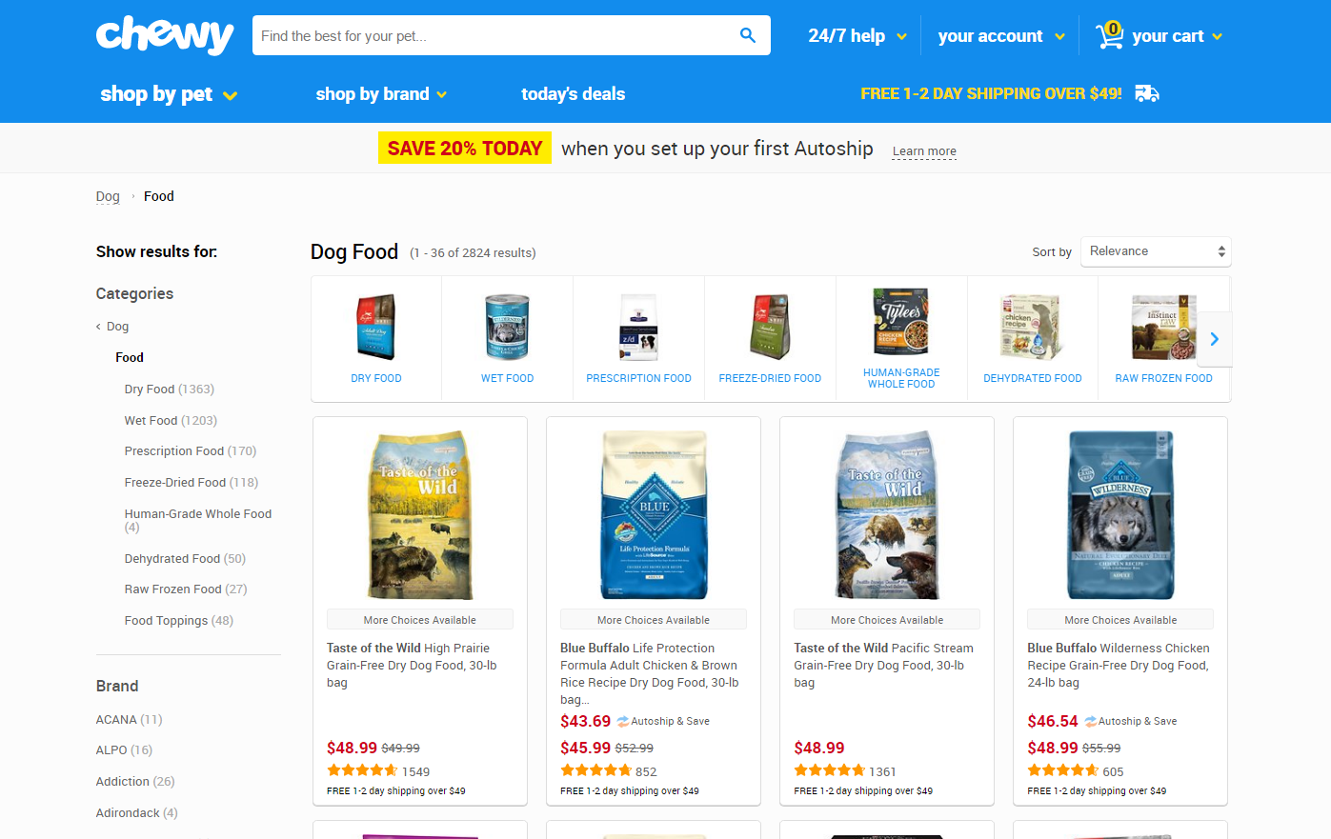
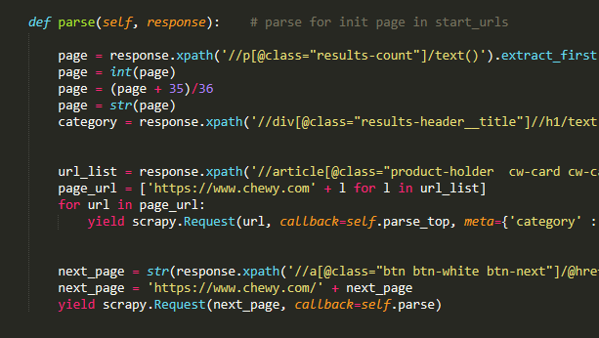

Slide 6
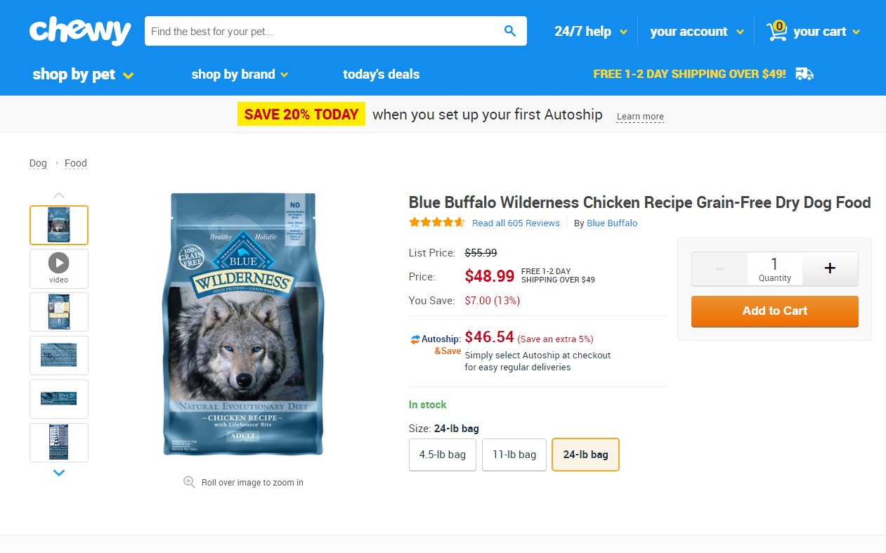

Slide 7
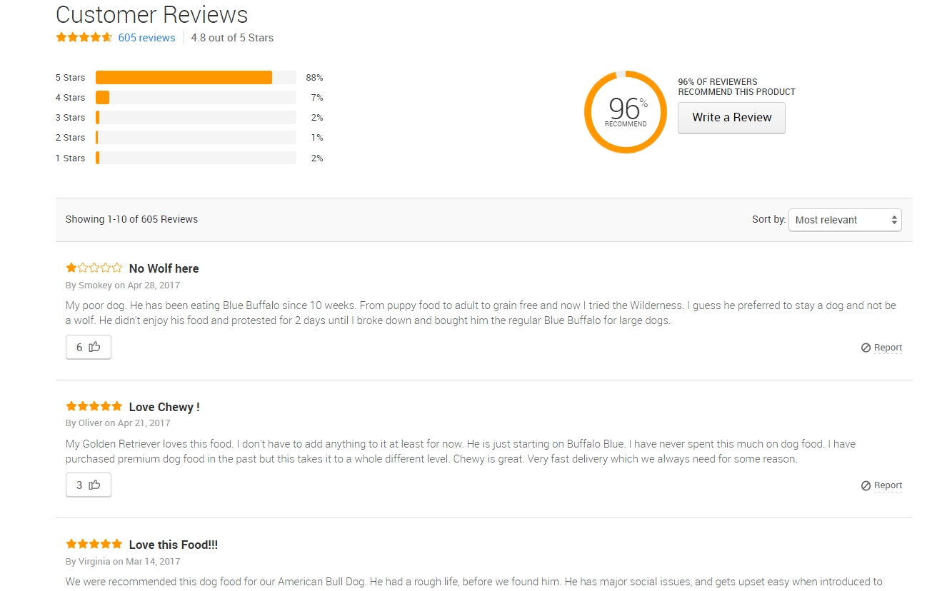
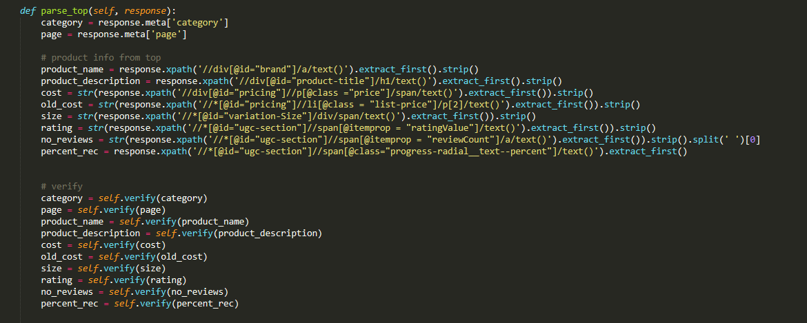

Slide 8
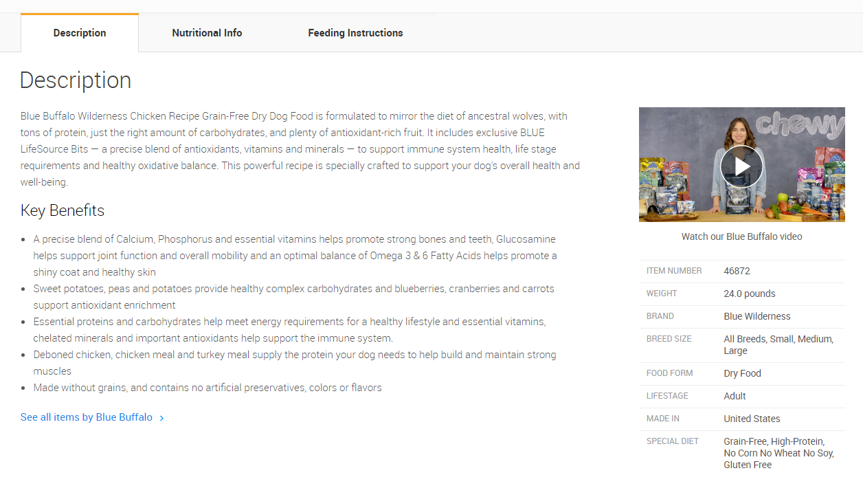
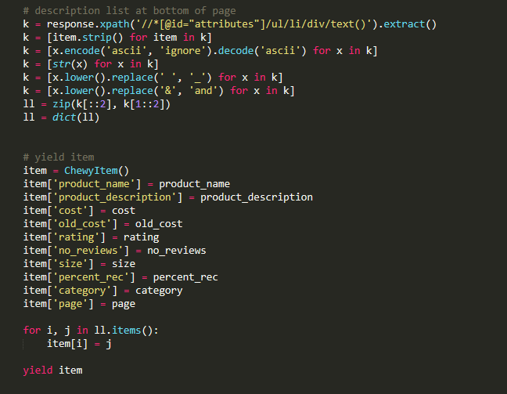

Slide 9
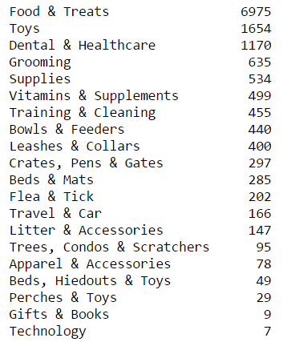
Cleaning and Pre-processing the Data
Numeric columns
Pet and Item Type
Missing Values
Notes:
Food & Treats had average rating of 4.53 (second highest after gifts & books),
Toys had lost average rating at 3.98 (only one below 4)
Dental & Healthcare had average rating of 4.47 (4th highest)

Slide 10
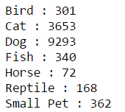
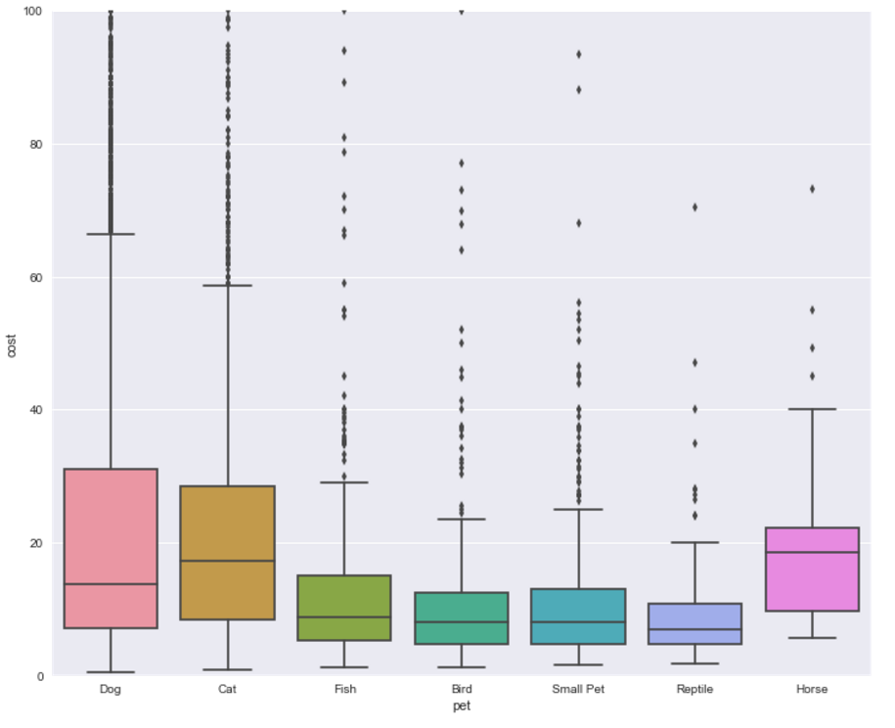
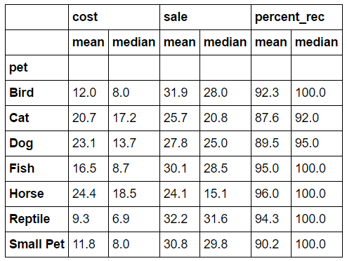

Slide 11

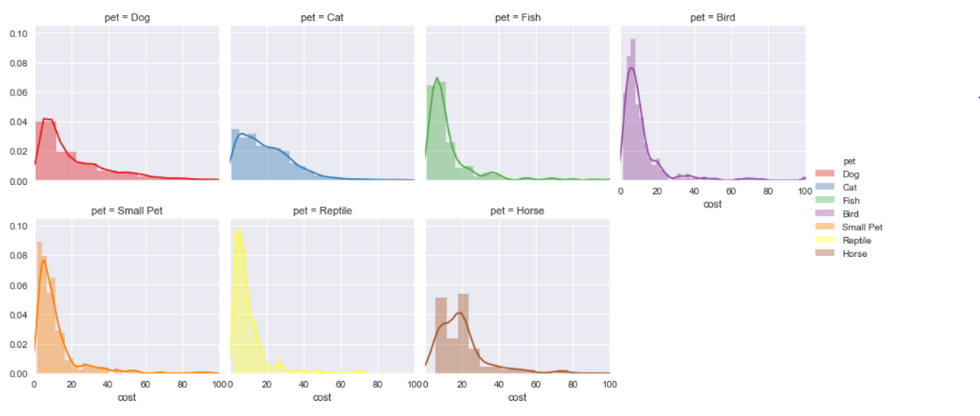

Slide 12
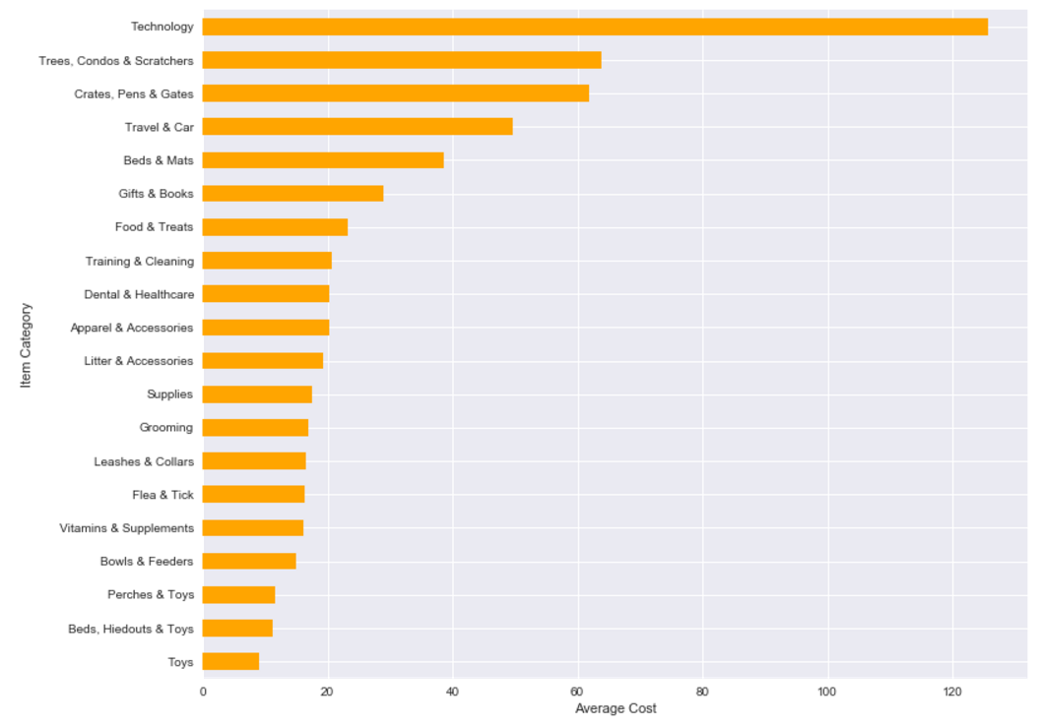
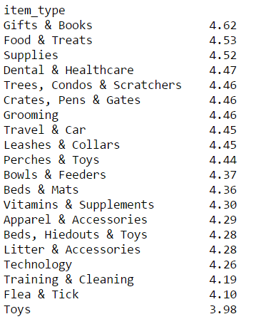
Notes:
Food & Treats had average rating of 4.53 (second highest after gifts & books),
Toys had lost average rating at 3.98 (only one below 4)
Dental & Healthcare had average rating of 4.47 (4th highest)

Slide 13
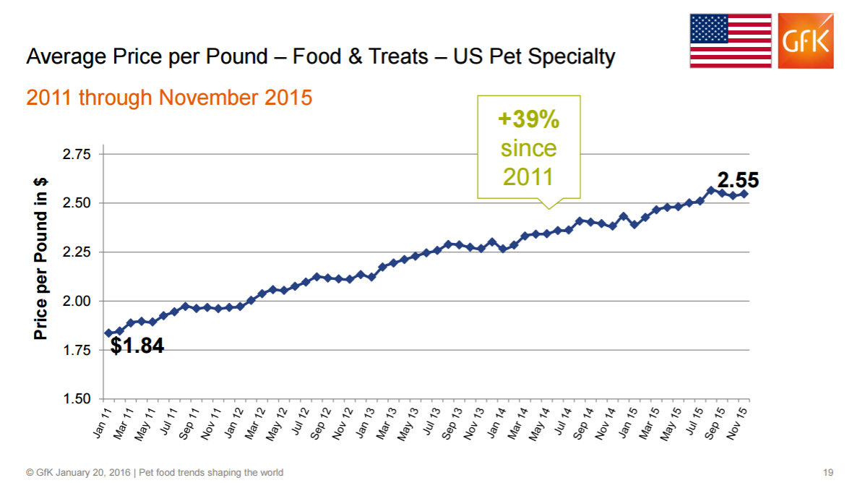
https://pida.memberclicks.net/assets/PILC16presentations/pilc%20lange%20petfood%20trends%20shaping%20the%20world.pdf

Slide 14
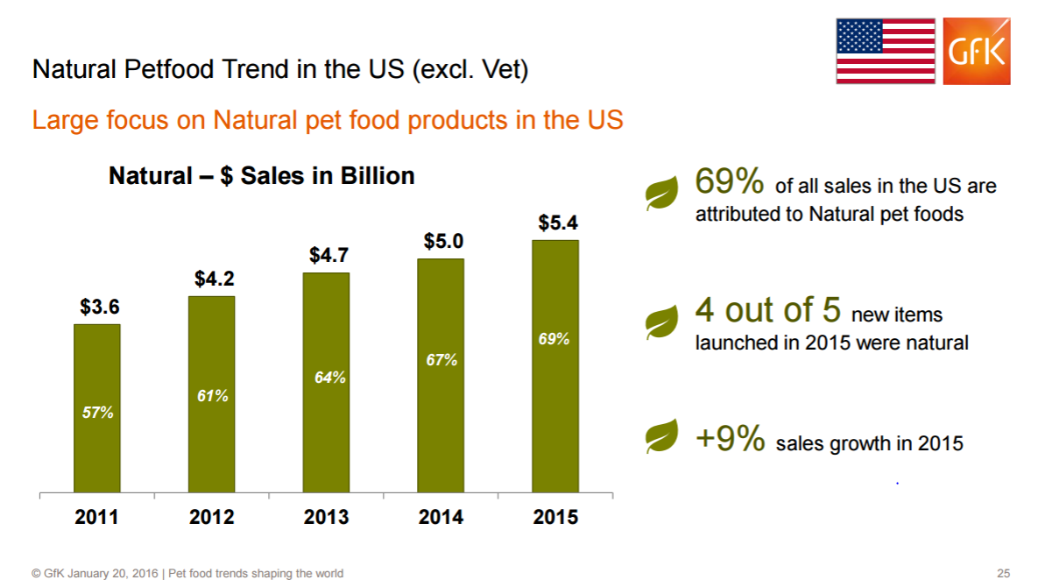

Slide 15
http://www.adventuretravelnews.com/the-millennial-generation-is-changing-the-way-we-travel
they travel on average 4.2 times per year compared to 2.9 and 3.2 times per year for older generations. 1 in 3 U.S. Pet Owners Millennials: What it Means for the Pet Food Market
More than half (55%) of Millennial pet owners are willing to try holistic and natural-branded nutritional supplements before resorting to conventional pet medication, as opposed to only 30% of owners 35 and over. When the only option left is to buy conventional pet medication however, more than half (52%) of Millennials buy meds oppose to only 28% of any other demographic.
Nearly three-quarters (69%) of Millennial pet owners are more likely to consider foods whose recipes use naturally-made ingredients over “normal,” mass-produced foods, versus fewer than half (44%) of owners over 35.
Three-quarters (75%) of Millennial dog owners agree that fear of pet food contamination or product safety is a key consideration in the foods they buy, compared to only 66% of their older counterparts. Almost two-thirds (64%) of Millennial cat owners compared to just 49% of other owners are likely to feel the same way. Today, pet food companies are increasingly vigilant in their internal protocols for indentifying safety issues, and it’s not uncommon for companies to recall as much as a week’s worth of product when just one line of product is found to be contaminated. One pet company, Evanger's Dog and Cat Food, did just this in February 2017 after a potential contaminant was found in one of its products. The food was linked to illness in five dogs that ate it (and one of the dogs died).
Millennials are on the lookout for products whose labeling is transparent and green, and are most likely to use pet foods with formulations geared toward enhancing the health of their pets, including pet foods characterized as organic, holistic, non-GMO, and grain-free.
Scientific messaging wors better for millennials and emotional messaging works better for boomers
Notes:
https://www.packagedfacts.com/Content/Blog/2017/02/07/1-in-3-US-Pet-Owners-Millennials-What-it-Means-for-the-Pet-Food-Market

Slide 16
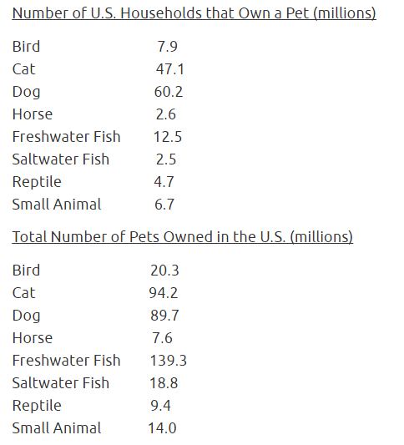
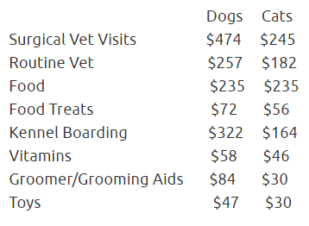
http://www.americanpetproducts.org/press_industrytrends.asp

Slide 17
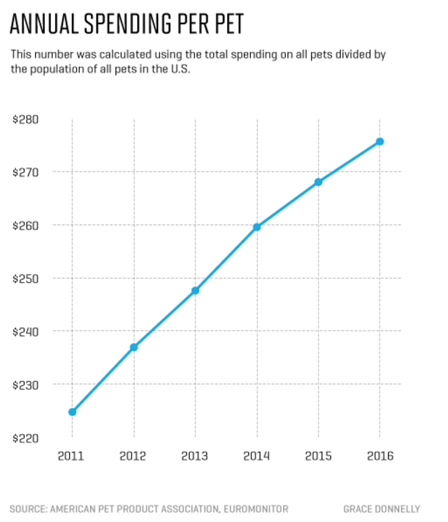
http://fortune.com/2016/09/07/pets-are-basically-people/

Slide 18
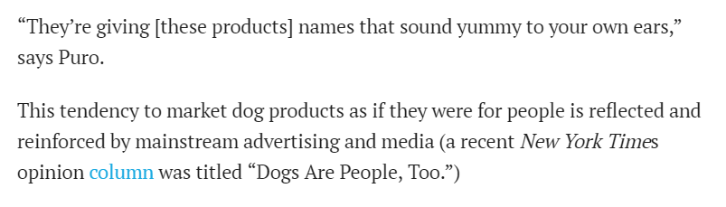
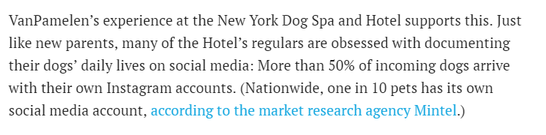

Slide 19
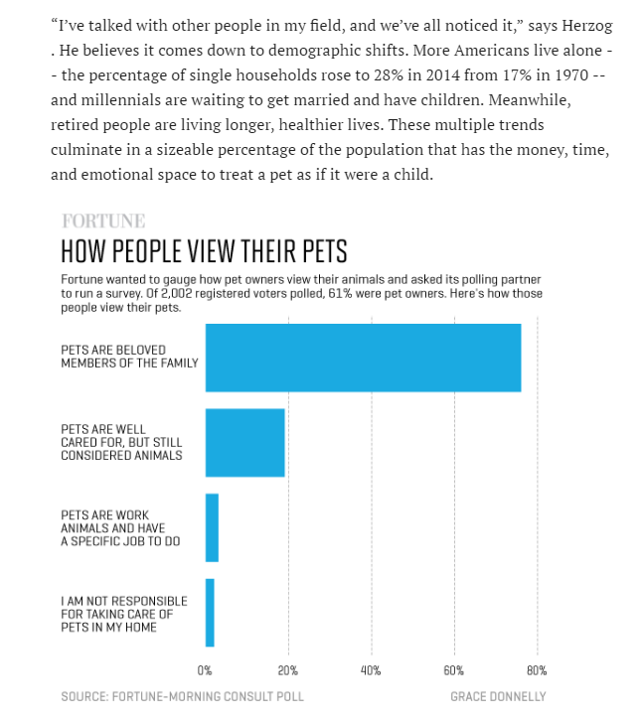

Slide 20



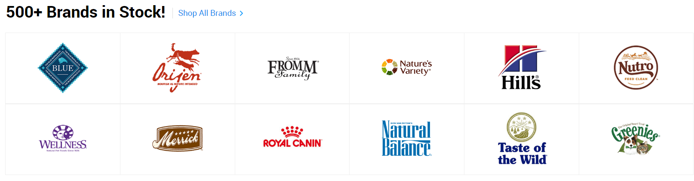

Slide 21
Conclusions:

Slide 22
Future Work and Further Questions
Product sales
Textual analysis of reviews
Focus on food & nutrition
Comparison to other online pet supply stores
Notes:
Personal developments:
I used python for everything to get the experience, but I would like to choose more effectively between R and python in the future
Scrape something more challenging, more items, tougher layout, ads involved, bots
Experiment with Bokeh and more statistical analysis

Slide 23
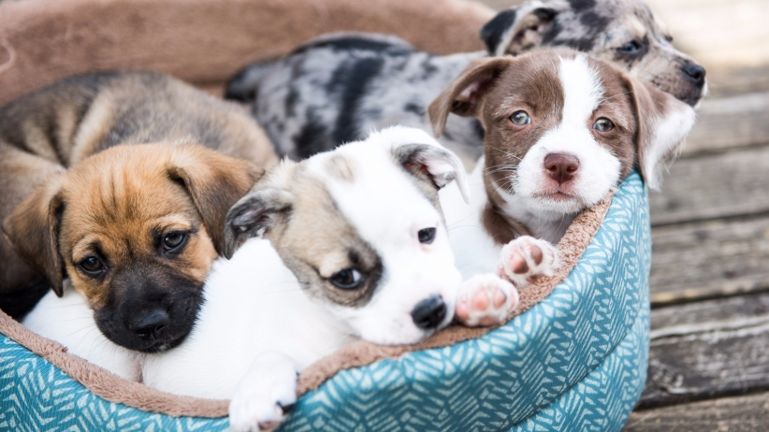
https://www.entrepreneur.com/article/190440

Slide 24
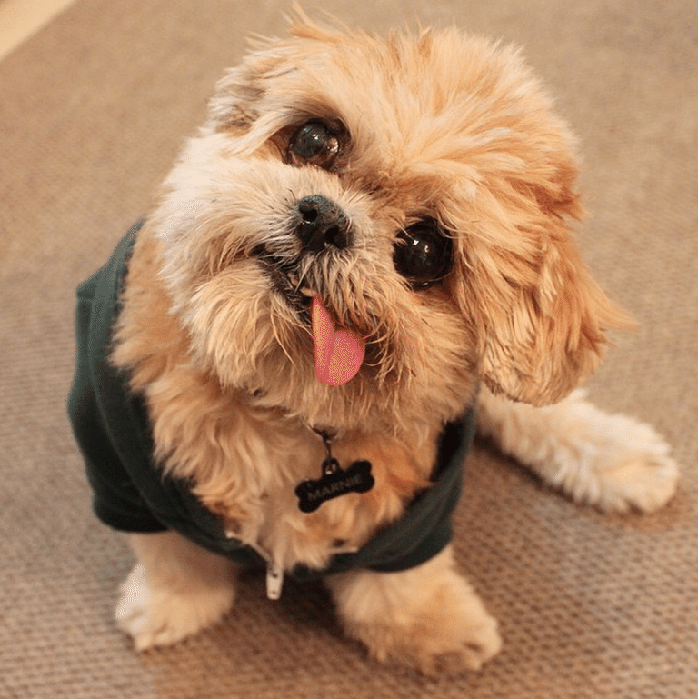
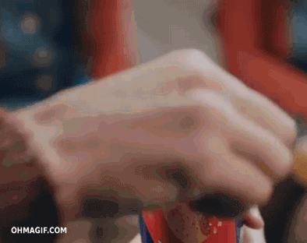
Any Questions?
https://www.lifewire.com/internet-famous-dogs-3485776

Slide 25
Thank You

Slide 26
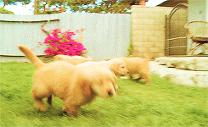

Slide 28
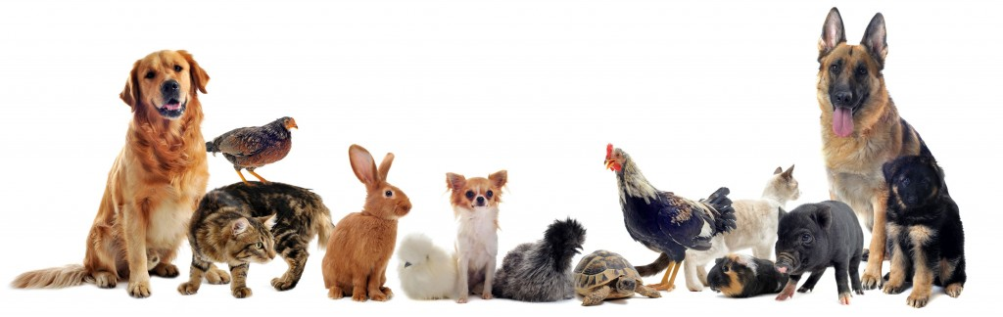
http://stayathomepetservices.com/our-services/

Slide 29
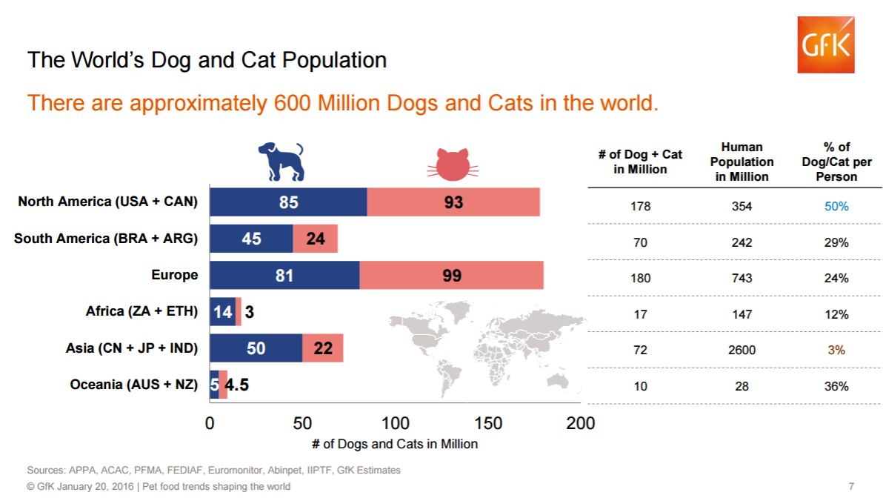

Slide 30
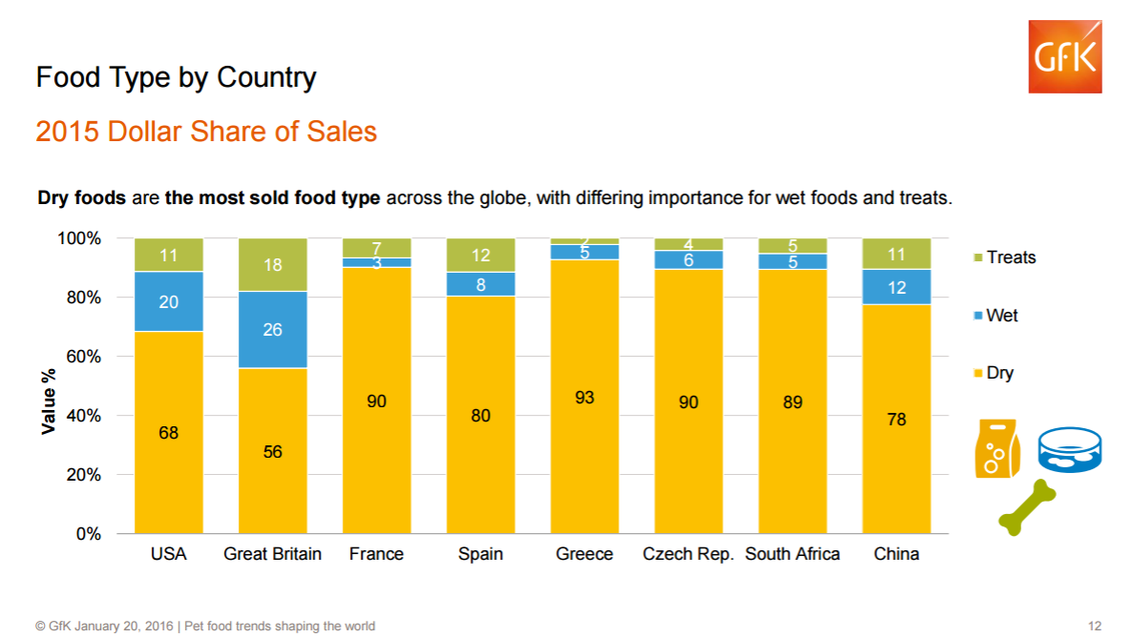

Slide 31
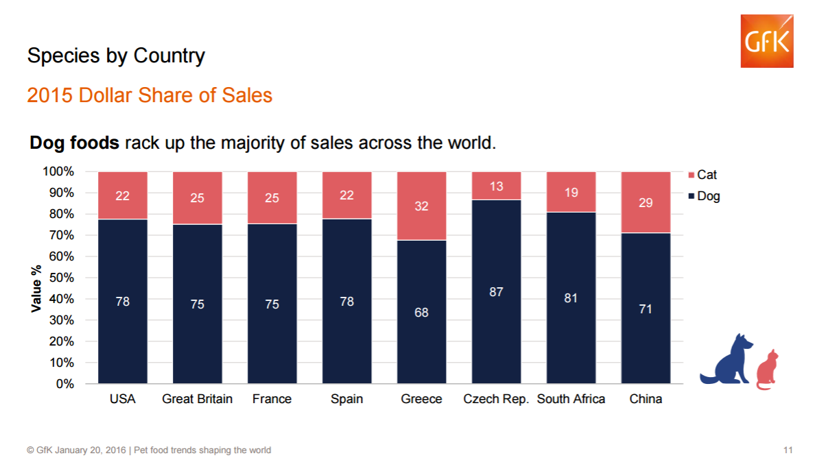

Slide 32
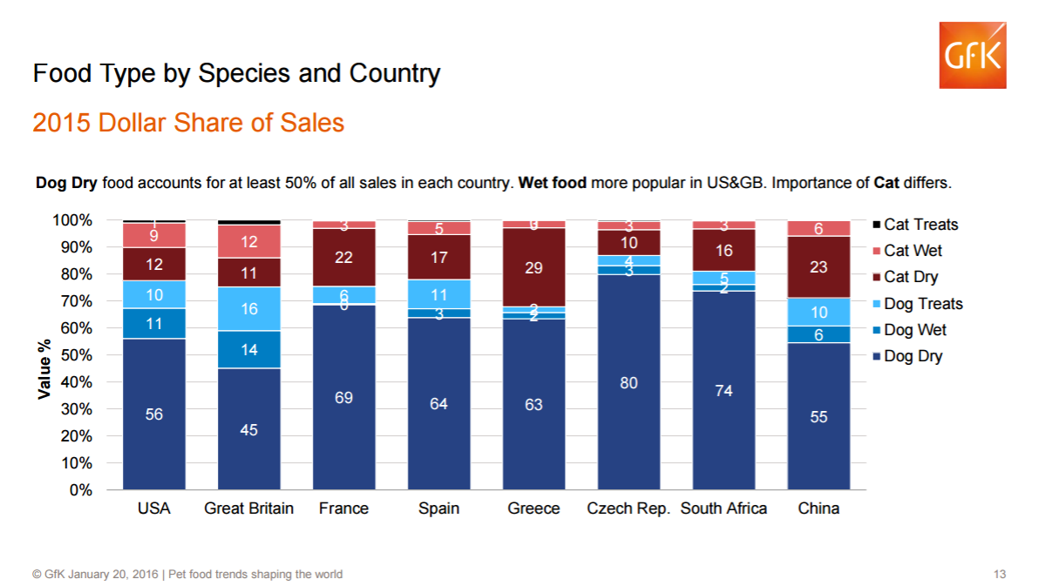

Slide 33
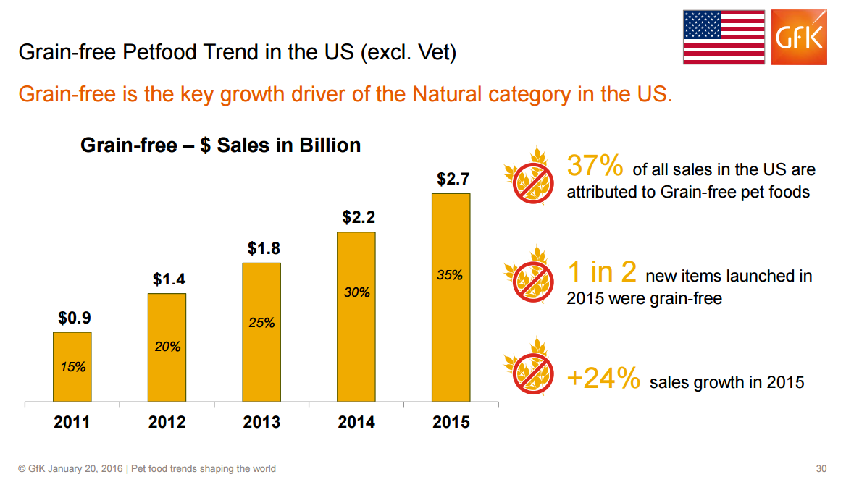

Slide 34
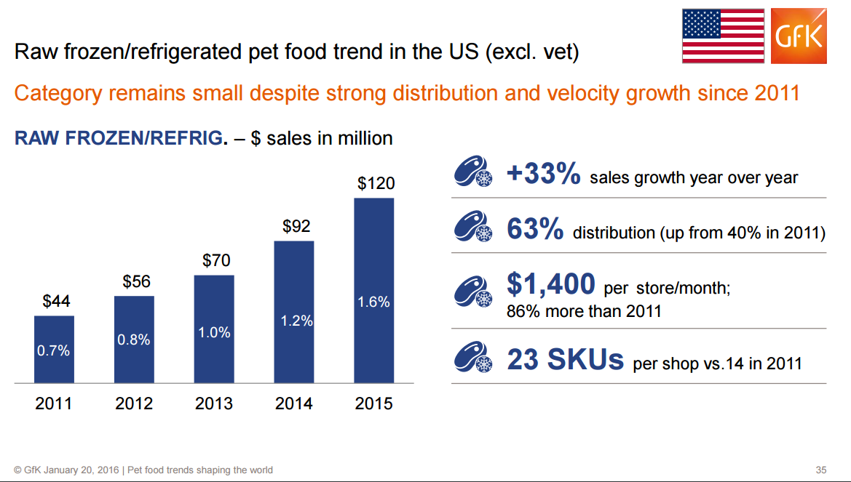

Slide 35
